Slide 1
LC3

Slide 2
von Neumann Architecture
Sometimes called the "Princeton Architecture".
Consists of:
Processing unit
Memory
Input
Output
Control Unit
The main feature is that the program instructions and data share the same memory and, therefore, use the same pathways (bus) internally.

Slide 3
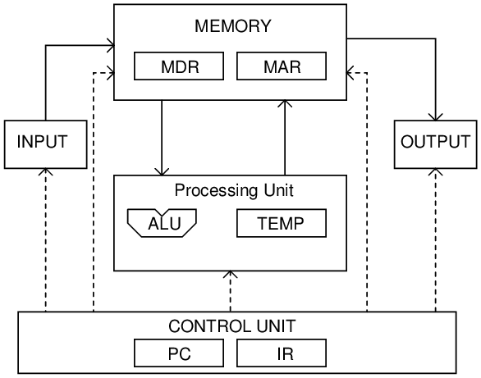
von Neumann Block Diagram

Slide 4
Memory
MAR - Memory Address Register – Address of the memory to read or write (16 bit).
MDR - Memory Data Register – Temporary storage for he data to put into memory on write or data from memory on a read (16 bit).
And memory, of course.
How many?
What size?

Slide 5
Input/Output
KBDR – KeyBoard Data Register – holds the ASCII character of the key struck
KBSR – KeyBoard Status Register – status information
DDR – Display Data Register – holds the ASCII character to display on the screen
DSR – Display Status Register – status information

Slide 6
Processing
Executing commands
ALU – Arithmetic/Logic Unit – Math and logical operations such as AND.
R0 – R7 Registers for holding temporary data and results

Slide 7
Control Unit
IR – Instruction Register – holds the currently executing instruction
PC – Program counter – address of next instruction in memory
Finite State Machine – 1s and 0s to all circuitry to coordinate all operations in the microprocessor.

Slide 8
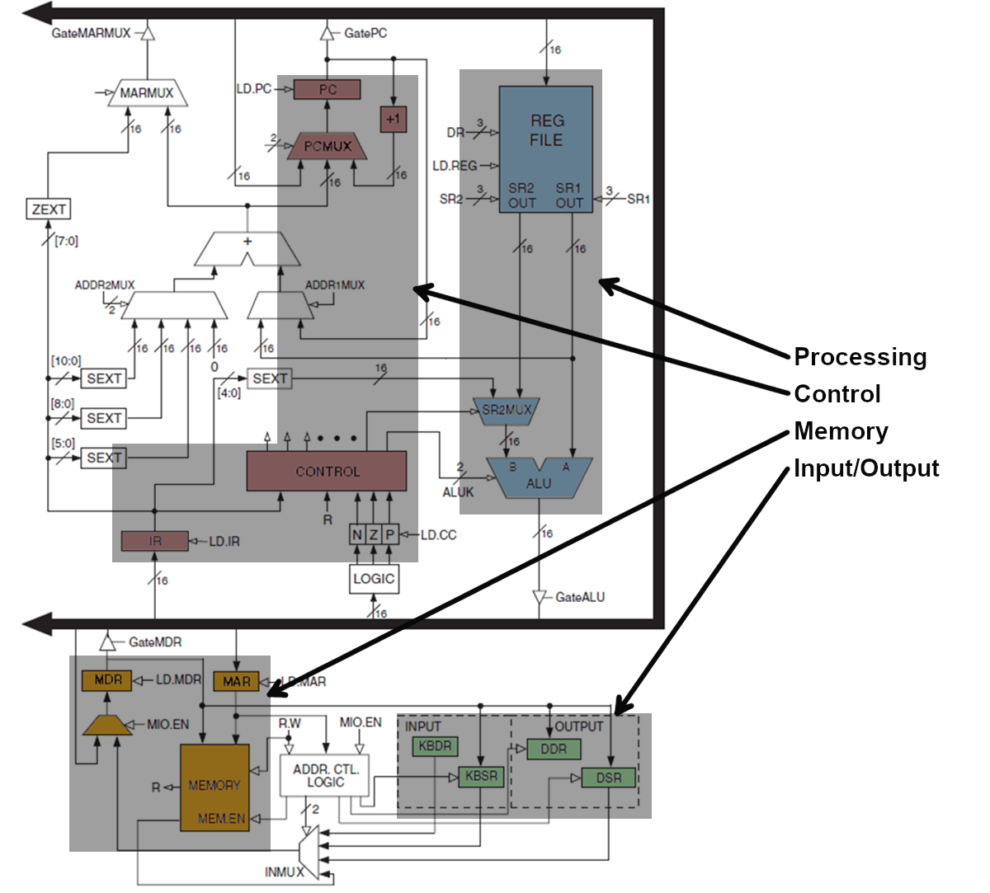
LC3 circuit diagram with blocks labeled

Slide 9
Instruction Processing
Fetch – Execute cycle
Fetch - load instruction from memory into IR
Decode – figure out the operation
Evaluate addresses of operands
Load operands
Execute - perform the desired operation
Store the results

Slide 10
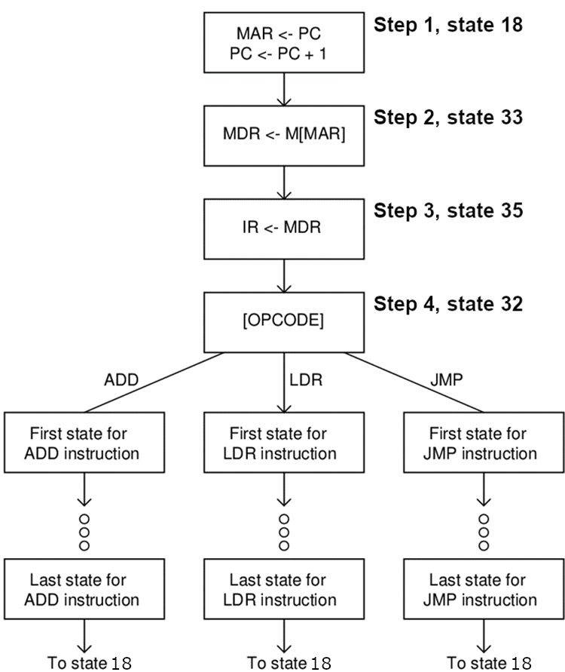
Abbreviated Lc3 state diagraM
See appendix C figure C2 on page 568 for full diagram.

Slide 11
Loading the instruction
Register Transfer Language
BUS <- PC , PC <- PC + 1
MAR <- BUS
(Usually the BUS transfer is implied)
MAR <- PC, PC <- PC + 1
PC
Program Counter (Register)
Contains address of next instruction.
MAR
Memory Address Register
Contains address in the memory unit

Slide 12
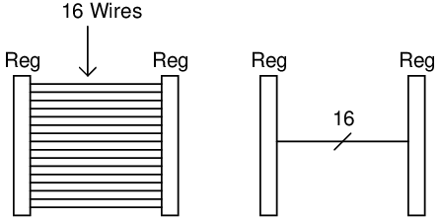
BUS
Transfer of data from a source register to a destination register requires each single bit be connected with a wire.
We sometimes show an abbreviated form.

Slide 13
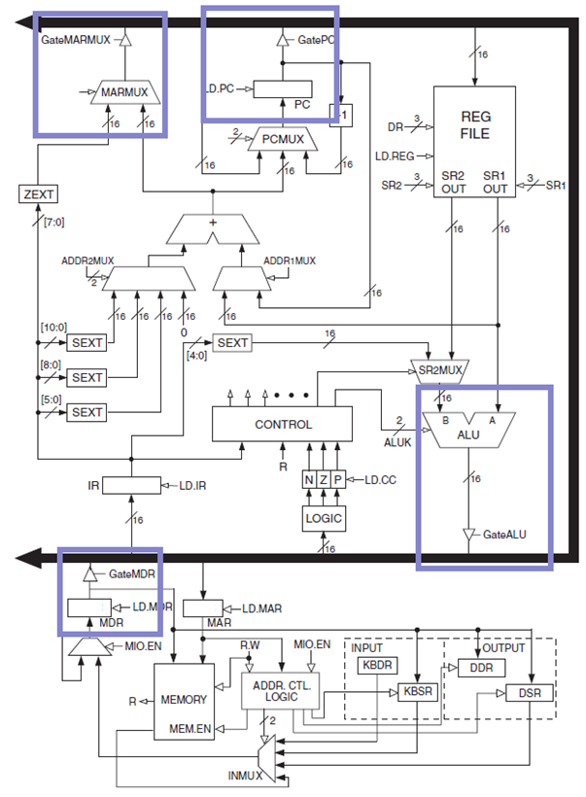
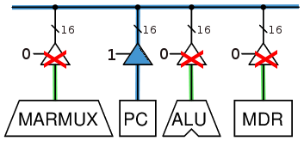
Bus with Tristate Buffers

Slide 14
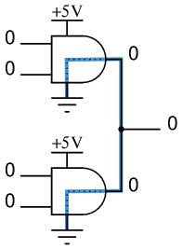
Why use a Tristate Buffer 1
The BUS can only have one input active at a time.
Imagine this circuit
0 = Ground
1 = 5V
What if both gates are 0?
What if both gates are 1?
What if one is 0 and the other is a 1?

Slide 15
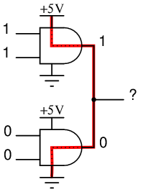
Why use a Tristate Buffer 2
The BUS can only have one input active at a time.
Imagine this circuit
0 = Ground
1 = 5V
What if both gates are 0?
What if both gates are 1?
What if one is 0 and the other is a 1?

Slide 16
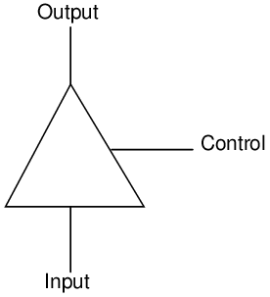
A Tristate Buffer
Tristate buffers have three outputs
(0, 1, and Open)
Open means the input is disconnected entirely from the circuit.
Control | Input | Output
0 | 0 | Open
0 | 1 | Open
1 | 0 | 0
1 | 1 | 1

Slide 17
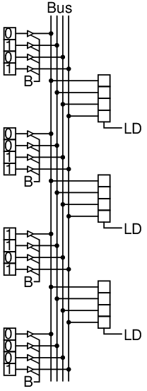
BUS Operation

Slide 18
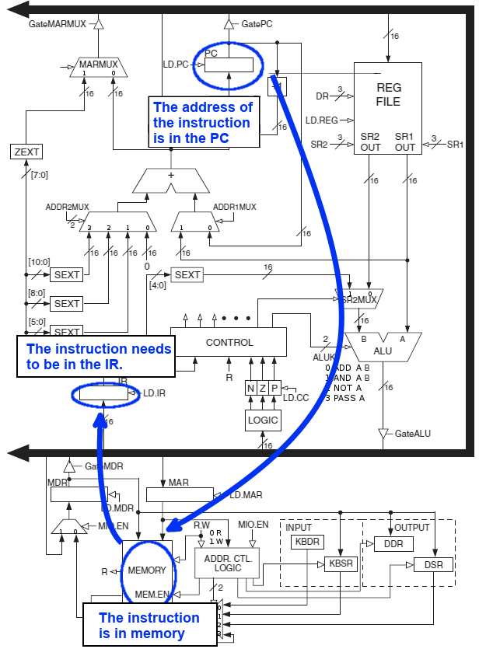
Loading an instruction
Move the address from the PC to the MAR
Look up the instruction in memory and move the instruction to the MDR
Move the instruction from the MDR to the IR.

Slide 19
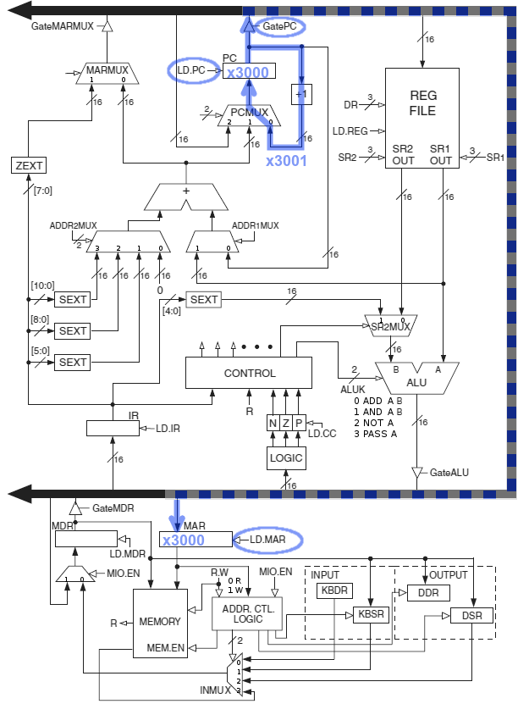
Step 1 of loading the next instruction
MAR<-PC
PC<-PC+1
Move the address from PC to the MAR
Increment the PC.

Slide 20
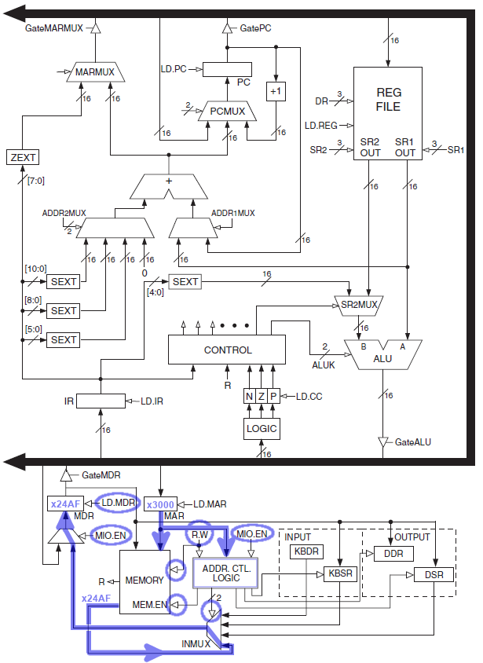
Step 2 of loading the next instruction
MDR <- M[MAR]
Look up address stored in MAR in memory.
Move the value from that memory to MDR.

Slide 21
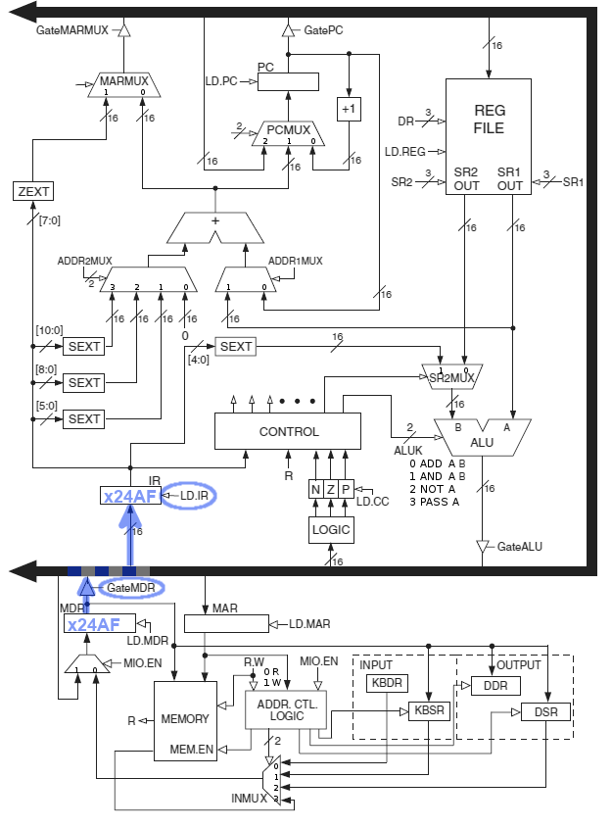
Step 3 of loading the next instruction
IR <- MDR
Move the instruction from the MDR to the IR.

Slide 22
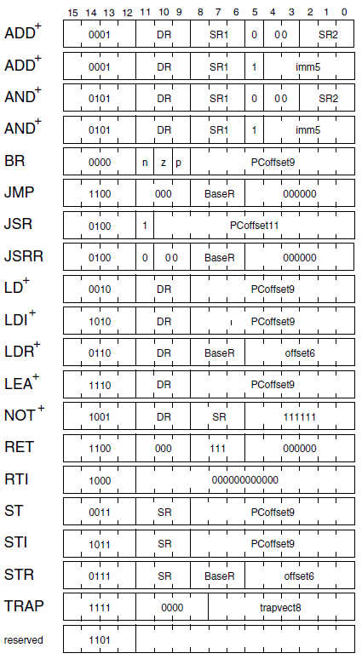
Appendix A for reference for this example

Slide 23
Stopping the Computer
The operating system is a program.
Normally we don’t want the operating system to stop. (Only when shutting down the computer)
In the LC3 we use our "Operating System" to shut down processing.
Stopping execution is sometimes known as a HALT.
We WANT to halt the LC3 at the end of every program we run.
The instruction to do that is a TRAP. Trap instructions are like function calls to the operating system and will be discussed in detail.
For now, you just need to know how to halt. The instruction is:
Hex: F025
Binary: 1111000000100101

